Slide 1

KAFKA

Slide 2
CONTENTS
Apache Kafka Architecture
Pub-Sub messaging
Creating a Kafka topic
Retrieve list of topics

Slide 3
Apache Kafka Architecture
Apache Kafka is a distributed streaming platform that offers four key APIs: the Producer API, Consumer API, Streams API, and Connector API with features such as redundant storage of massive data volumes and a message bus capable of throughput reaching millions of messages each second.
These capabilities and more make Kafka a solution that’s tailor-made for processing streaming data from real-time applications.

Slide 4
Kafka is essentially a commit log with a simplistic data structure.
The Kafka Producer API, Consumer API, Streams API, and Connect API can be used to manage the platform, and the Kafka cluster architecture is made up of Brokers, Consumers, Producers, and ZooKeeper.
Apache Kafka’s architecture actually delivers an easier to understand approach to application messaging than many of the alternatives.
Kafka is essentially a commit log with a very simplistic data structure.
It just happens to be an exceptionally fault-tolerant and horizontally scalable one.

Slide 5
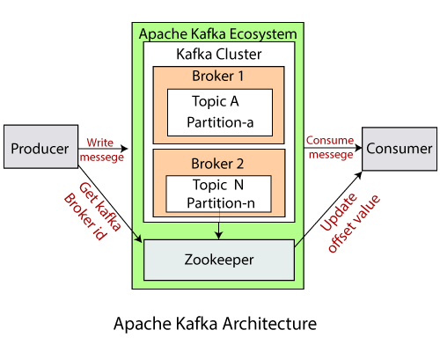
The main Kafka components are topics, producers, consumers, consumer groups, clusters, brokers, partitions, replicas, leaders, and followers.
The following diagram offers a simplified look at the interrelations between these components.

Slide 6
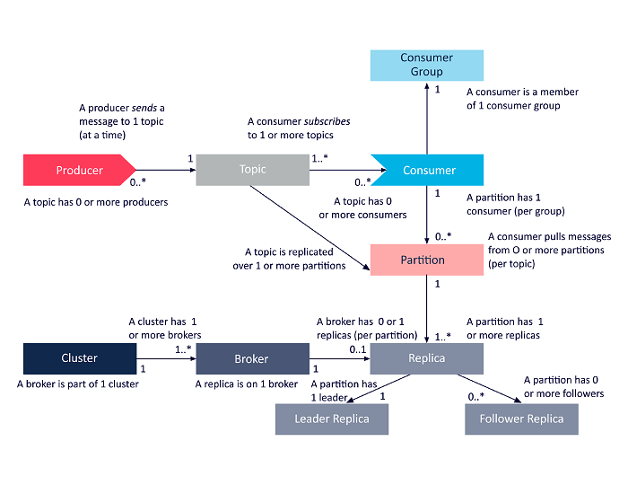

Slide 7
Apache Kafka offers four key APIst: the Producer API, Consumer API, Streams API, and Connector API.
Let’s take a brief look at how each of them can be used to enhance the capabilities of applications:
Producer API
The Kafka Producer API enables an application to publish a stream of records to one or more Kafka topics.

Slide 8
Consumer API
The Kafka Consumer API enables an application to subscribe to one or more Kafka topics.
It also makes it possible for the application to process streams of records that are produced to those topics.
Streams API
The Kafka Streams API allows an application to process data in Kafka using a streams processing paradigm.

Slide 9
With this API, an application can consume input streams from one or more topics, process them with streams operations, and produce output streams and send them to one or more topics.
In this way, the Streams API makes it possible to transform input streams into output streams.
Connect API
The Kafka Connector API connects applications or data systems to Kafka topics.

Slide 10
This provides options for building and managing the running of producers and consumers, and achieving reusable connections among these solutions.
For instance, a connector could capture all updates to a database and ensure those changes are made available within a Kafka topic.

Slide 11
Pub-Sub Messaging
In Kafka Workflow, Kafka is the collection of topics which are separated into one or more partitions and partition is a sequence of messages, where index identifies each message (also we call an offset).
However, in a Kafka cluster, all the data is the disjoint union of partitions.
The incoming messages are present at the end of a partition, hence consumer can read them.

Slide 12
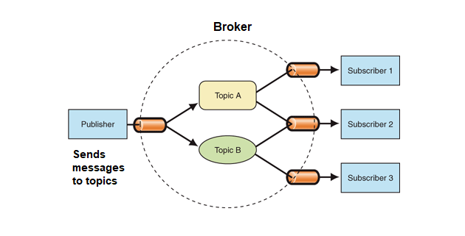
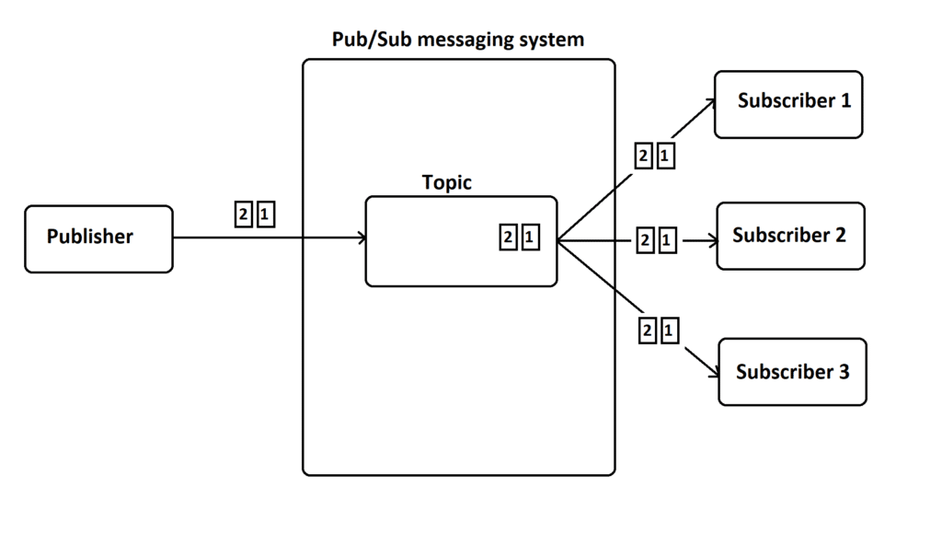

Slide 13
Also, by replicating the messages to different brokers, it maintains durability.
In a very fast, reliable, persisted, fault-tolerance and zero downtime manner, Kafka offers a Pub-sub and queue-based messaging system.
Moreover, producers send the message to a topic and the consumer can select any one of the message systems according to their wish.

Slide 14
Workflow of Pub-Sub Messaging
In Apache Kafka, the stepwise workflow of the Pub-Sub Messaging is:
At regular intervals, Kafka Producers send the message to a topic.
Kafka Brokers stores all messages in the partitions configured for that particular topic, ensuring equal distribution of messages between partitions. For example, Kafka will store one message in the first partition and the second message in the second partition if the producer sends two messages and there are two partitions.

Slide 15
Moreover, Kafka Consumer subscribes to a specific topic.
Once the consumer subscribes to a topic, Kafka offers the current offset of the topic to the consumer and save the offset in the Zookeeper ensemble.
Also, the consumer will request the Kafka in a regular interval, for new messages (like 100 Ms).
Kafka will forward the messages to the consumers as soon as received from producers.

Slide 16
The consumer will receive the message and process it.
Then Kafka broker receives an acknowledgment of the message processed.
Further, the offset is changed and updated to the new value as soon as Kafka receives an acknowledgment.
Even during server outrages, the consumer can read the next message correctly, because ZooKeeper maintains the offsets.

Slide 17
However, until the consumer stops the request, the flow repeats.
As a benefit, the consumer can rewind/skip any offset of a topic at any time and also can read all the subsequent messages, as a par desire.

Slide 18
Creating a Kafka topic
Kafka maintains feeds of messages in categories called topics.
Producers write data to topics and consumers read from topics.
Since Kafka is a distributed system, topics are partitioned and replicated across multiple nodes.
Kafka treats each topic partition as a log (an ordered set of messages).
Each message in a partition is assigned a unique offset.

Slide 19
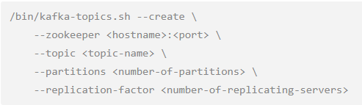
Each topic has a user-defined category (or feed name), to which messages are published.
To create a Kafka topic, run kafka-topics.sh and specify topic name, replication factor, and other attributes:

Slide 20
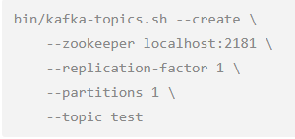

The following example creates a topic named "test", with one partition and one replica:
To view the topic, run the list topic command:

Slide 21
The auto.create.topics.enable property, when set to true, automatically creates topics when applications attempt to produce, consume, or fetch metadata for a nonexistent topic.

Slide 22
Retrieve list of topics
Writing data from the console and writing it back to the console is a convenient place to start, but you'll probably want to use data from other sources or export data from Kafka to other systems.
For many systems, instead of writing custom integration code you can use Kafka Connect to import or export data.
Kafka Connect is a tool included with Kafka that imports and exports data to Kafka.

Slide 23
It is an extensible tool that runs connectors, which implement the custom logic for interacting with an external system.
In this quickstart we'll see how to run Kafka Connect with simple connectors that import data from a file to a Kafka topic and export data from a Kafka topic to a file.
First, we'll start by creating some seed data to test with:
> echo -e "foo\nbar" > test.txt
> bin/connect-standalone.sh config/connect-standalone.properties config/connect-file-source.properties config/connect-file-sink.properties

Slide 24
These sample configuration files, included with Kafka, use the default local cluster configuration you started earlier and create two connectors: the first is a source connector that reads lines from an input file and produces each to a Kafka topic and the second is a sink connector that reads messages from a Kafka topic and produces each as a line in an output file.
During startup you'll see a number of log messages, including some indicating that the connectors are being instantiated.
Once the Kafka Connect process has started, the source connector should start reading lines from
test.txt

Slide 25
and producing them to the topic
connect-test
, and the sink connector should start reading messages from the topic
connect-test
and write them to the file
test.sink.txt
. We can verify the data has been delivered through the entire pipeline by examining the contents of the output file:
> cat test.sink.txt
foo
bar

Slide 26
Note that the data is being stored in the Kafka topic
connect-test
, so we can also run a console consumer to see the data in the topic (or use custom consumer code to process it):
> bin/kafka-console-consumer.sh --zookeeper localhost:2181 --topic connect-test --from-beginning
{"schema":{"type":"string","optional":false},"payload":"foo"}
{"schema":{"type":"string","optional":false},"payload":"bar"}
...

Slide 27
The connectors continue to process data, so we can add data to the file and see it move through the pipeline:
> echo "Another line" >> test.txt
You should see the line appear in the console consumer output and in the sink file.

Slide 28
END OF SESSION
Q&A

